Slide 1
NO BEES NO FUTURE OXLEY PARK PUBLIC SCHOOL
In collaboration with
Richmond Agricultural College
Centre of Excellence in Agricultural Education
Western Sydney University, Hawkesbury Campus
2020

Slide 3
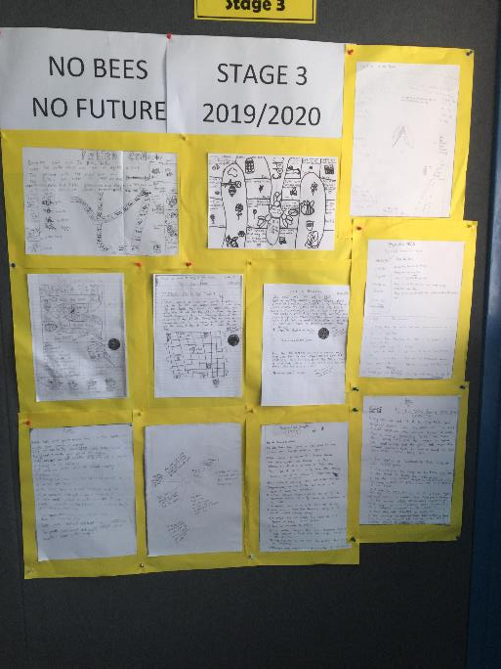
School Foyer

Slide 4
Infographics created by S3J
Nikhill, Nitish, Afya and Jazzmine.
This is the final infographic we have submitted for the competition July 2020.
This infographic poster was made using Piktochart software and QR Code Generator.

Slide 5
Additional infographic and research prepared by Nikhill S3J.

Slide 6
Board Game research, design and development team S3J
Game design by Afya, Jazzmine, Nikhill, Nitish and Dwayne

Slide 7
Students researched bee facts and made
Bee Knowledge cards. To play the game when you land on a bee knowledge card you need to answer it correctly to move forward. The game pieces were made using Tinkercad and Thingiverse software and were printed using a 3D printer and then coloured in with texta

Slide 8
Game pieces made using Tinkercad and a 3D printer.

Slide 9
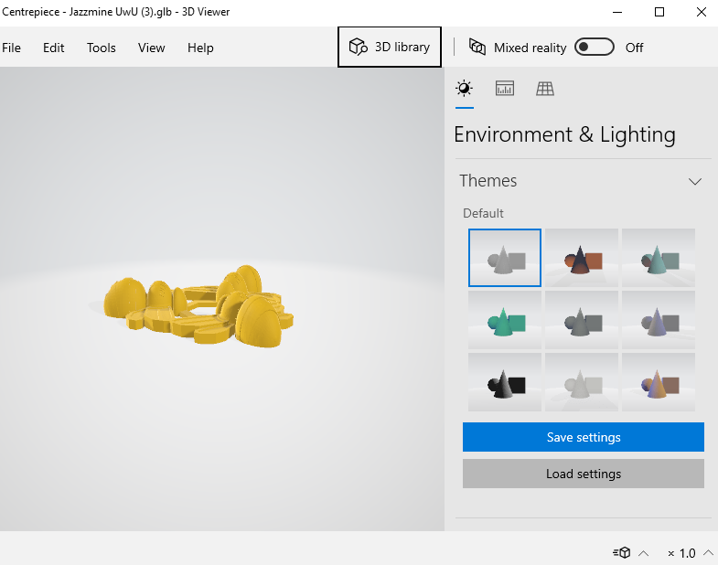
Testing the design of the game pieces

Slide 12
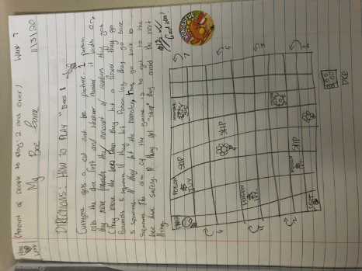
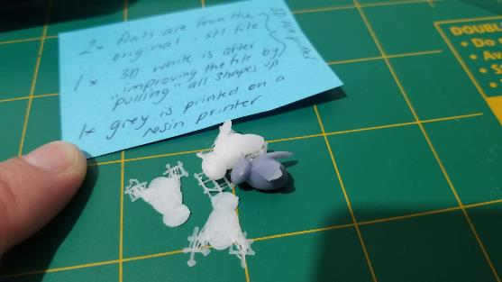

Slide 13
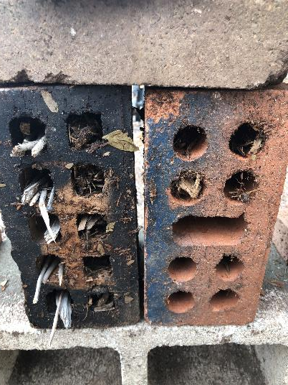
Native Bee Hotels and
The Habitat Garden

Slide 15
Bee Hotels

Slide 16
We have researched and planted bee friendly plants to encourage pollinators into the garden. This is a pumpkin patch. We are currently creating a habitat garden for small creatures and pollinators with a grant from Landcare Australia.

Slide 17
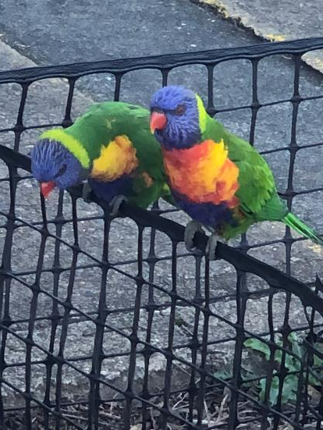
New residents in our Habitat Garden

Slide 18
Our School Vegetable Garden. Planting to introduce pollinators into the school.

Slide 19
Bee Hotels and Eco Open Day Assembly 2019
Student led research and presentation.

Slide 22
Environmental Activism and World Bee Day

Slide 23
Research Facts
One of the MOST WIDELEY USED pesticides are neonicotinoids and transferred by pollinators. It’s cross transferred to the bees. One bee gets infected and takes it back to the nest and infects others. The pesticide is also transferred by other pollinators.
BEE VIRUS – Varroa Destructor mite – sucks bee blood and circulates a virus
Plant Bee-friendly flowers and avoid pesticides.
Scientists in Tasmania CSIRO are undertaking a research project and putting sensors on the bees Its like an e-tag tracking their movements. University of Tasmania and CSIRO. Peter Norris Southern Tasmanian Beekeepers Association
China are hand pollinating due to drastic measures from Colony Collapse Disorder. All the worker bees are disappearing in pollination crisis!
America taking drastic measures to ship out 30,000 bees to various cranberry farms to help pollinate
30% of bees dying off each year.

Slide 24
Bee Research S23W

Slide 36
Thank you K-6 Environmental Activism – 2019/2020 S3C and S3W Bee Hotels & Research 2019 S23W Bee Research 2020 S3J – Infographics and Board Game 2020 Special thanks to: Nikhill, Nitish, Jazzmine, Afya and Dwayne

